Slide 1
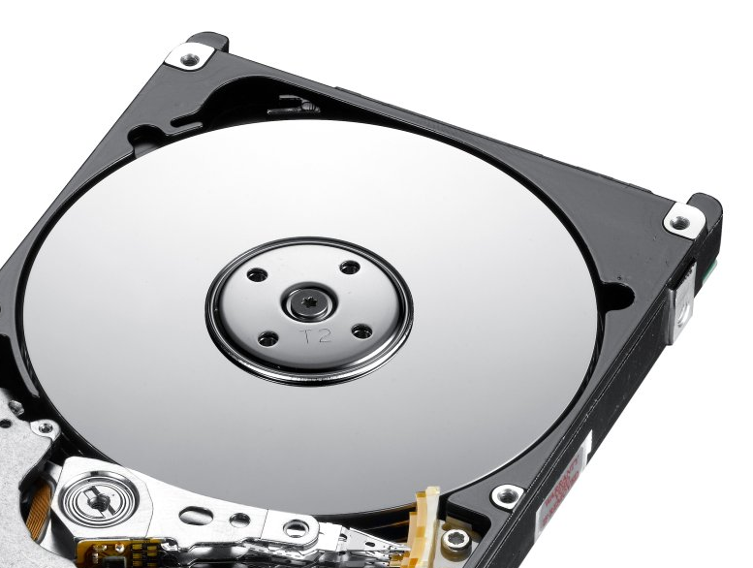
External Storage Structures
CE-2101 Algorithms and Data Structures

Slide 2
Disclaimer / Descargo de Responsabilidad
Esta presentación corresponde a una guía usada por el profesor durante las clases. La misma ha sido modificada para ser utilizado en el modelo de cursos asistidos por tecnología. No es una versión final, por lo que la misma podría requerir todavía hacer algunos ajustes. Para aspectos de evaluación esta presentación es solo una guía, por lo que el estudiante debe profundizar con el material de lectura asignado y lo discutido en clases para aspectos de evaluación.
This presentation corresponds to a guide material used by the professor during classes. It has been modified to be used in the model of technology-assisted courses. It is not a final version, so it may still require some adjustments. For evaluation aspects, this presentation is only a guide, so the student should delve with the assigned reading material and what has been discussed in class.

Slide 3
Introduction
Computer storage devices are typically classified into primary or main memory and secondary or peripheral storage
Primary storage usually refers to Random Access Memory
Secondary storage refers to devices such as hard disk drives, SSD, removable USBs...

Slide 4
What are differences between primary and secondary storage?

Slide 5
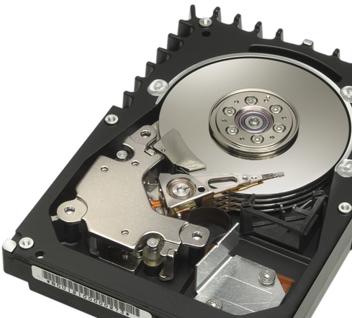
Hard disk drive
Often shortened as Hard disk, Hard drive or HDD
Non-volatile
Stores data in rapidly rotating rigid platters with magnetic surfaces

Slide 6
Hard disk drive
HDD is a sealed unit containing a number of platters in a stack
Electromagnetic read/write heads are positioned above and below each platter

Slide 7
Hard disk drive
Disk drives are often referred to as direct access storage devices
Meaning it takes almost the same time to access any record in a file
Contrast this to a tape...

Slide 8
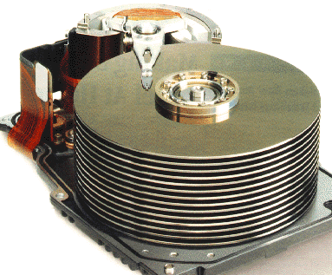
Hard disk drive Platters
Platter is a circular, metal disk that is mounted inside a hard disk drive.
Several platters are mounted on a fixed spindle motor to create more storage surfaces.

Slide 9
Hard disk drive Platters
The platters is made up of aluminium or glass substrate
Covered with a layer of Ferric Oxide or cobalt alloy

Slide 10
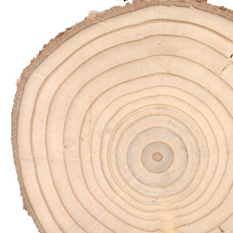
Hard disk drive Tracks
Each platter is divide into thousands concentric circles
These tracks resemble the structure of annual rings of a tree.
All the information is stored in tracks

Slide 11
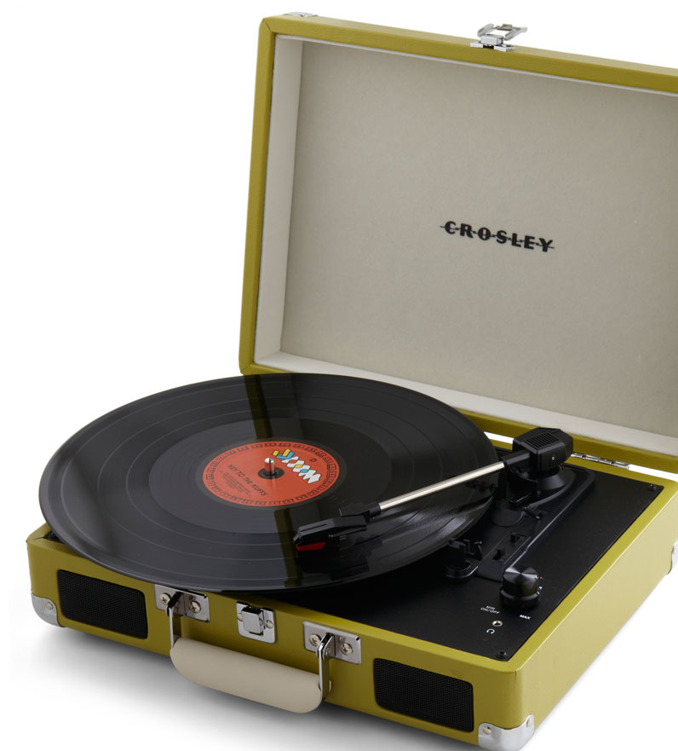
Hard disk drive Tracks
Outer track is the track 0
Each track can store large amount of data counting to thousands of bytes.
There are tracks in both sides of the platter

Slide 12
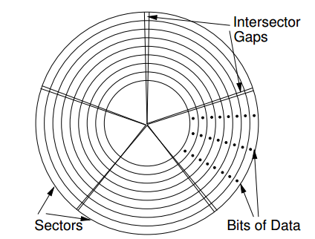
Hard disk drive Sectors
Each track is divide in small units called sectors.
It is the basic unit of data storage on a HDD
A single track can have thousands of sectors and each sector can hold more than 512 bytes.

Slide 13
Hard disk drive Sectors
A few additional bytes are needed to keep control structures and error detection and correction.
Sectors are grouped in clusters
Intersector gaps allows to detect the start and end of a sector

Slide 14
Hard disk drive Read / Write Heads
Interface between the magnetic field where the data is stored and electronic components in the hard disk.
Converts the bits to magnetic pulses when it is to be stored on the platter.
Performs the reverse process to read information from the disk

Slide 15
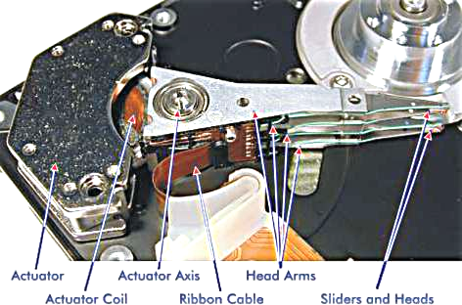
Hard disk drive

Slide 16
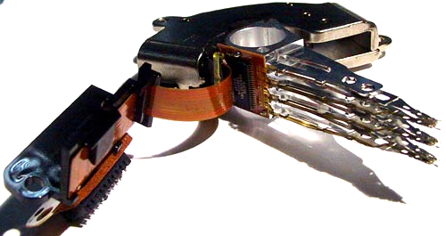
Hard disk drive

Slide 17
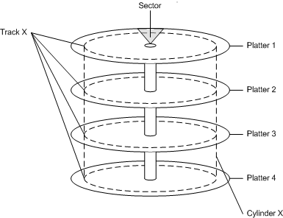
Hard disk drive

Slide 18
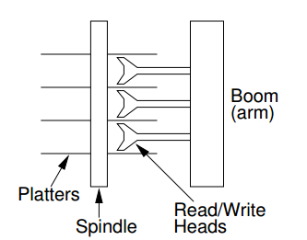
Hard disk drive

Slide 19
Hard disk drive Cylinder Method
Track 40, Surface 2
248
249
Sector Address = track number
+ cylinder number
+ surface number
+ register number
247
1
246
2
...
245

Slide 20
Hard disk drive Cylinder Method
If the platter has 200 tracks in each side, the disk has 200 cylinder
Each platter has two sides
If the disk has 11 platters, the surfaces are enumerated from 0 to 19

Slide 21
Hard disk drive Sector Method
Each track is divided in sector, each sector has a fixed storage space.
The address of the register is the address of the sector.

Slide 22
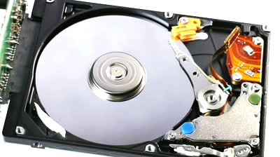
Hard disk drive
Disk Access Time
Moving Head
Access Time = Positioning Time
+ Head Activation Time
+ Rotational Delay
+ Transfer Time

Slide 23
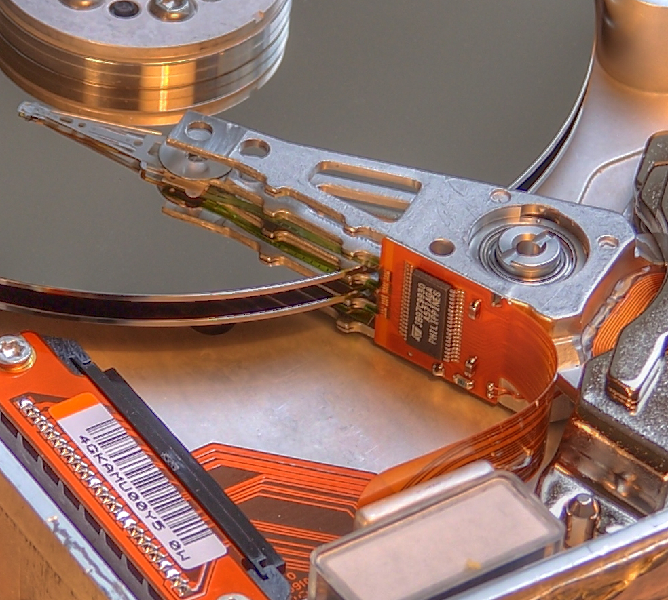
Hard disk drive
Disk Access Time
Static Head
There is a head per track
Access Time = Head Activation Time
+ Rotational Delay (sector selection)
+ Transfer Time

Slide 24
Hard disk drive
Types
IDE stands for Integrated Drive Electronics and it was a term used to differentiate a new hard drive technology
The IDE specification included the ATA interface. ATA stands for Advanced Technology Attachment

Slide 25
Hard disk drive
Types
When the Serial-ATA (SATA) was introduced, the Old ATA term was changed to PATA (parallel-ATA)
The IDE term is obsolete

Slide 26
Hard disk drive
Types
SCSI (Small Computer System Interface) is a set of standard to connect a computer with a device
Current versions of SCSI is SAS (Serial attached SCSI) which is a serial version of SCSI and is still being used

Slide 27
Disk Arrays
Data Striping
"... is a technique of divide logically sequential data (such a file) ... "
Mirroring
"... is the replication of logical disk volumes onto separate physical HDD in real time to ensure continuous availability ..."

Slide 28
Disk Arrays Parity Bit / Check Bit
Is a bit added to the end of a string of a binary code that indicates if the number of bits in the string is even (1) or odd (0)
Simplest form of error detecting code

Slide 29
Disk Arrays Parity Bit / Check Bit
Even parity bit: 1 if the number of ones of a given string of bits is odd
Odd parity bit: 1 if the number of ones is even.

Slide 30
Disk Arrays Parity Bit / Check Bit
Parity Bit/Check Bit
Data | Even | Odd
11001100 | 110011000 | 110011001
11111011 | 111110111 | 111110110
11001111 | 110011110 | 110011111
00110011 | 001100110 | 001100111
01111111 | 011111111 | 011111110
01010101 | 010101010 | 010101011

Slide 31
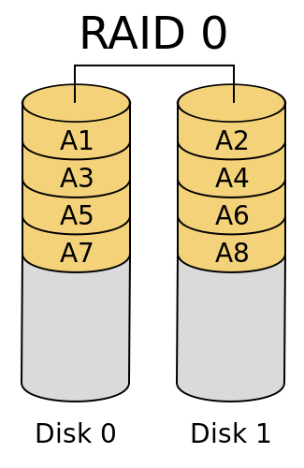
Disk Arrays RAID 0
Redundant Array of Inexpensive Disks
Block level striping
No parity
No mirroring
No redundancy
Performance Improvement
Additional Storage

Slide 32
Disk Arrays RAID 0
No fault tolerance
If one disk fail, destroy the entire array
Parallel Access
Minimum 2 disks

Slide 33
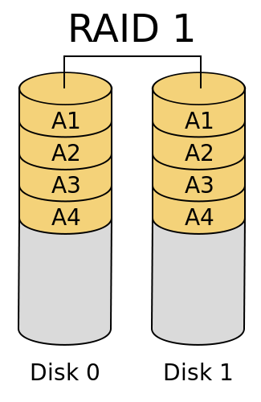
Disk Arrays RAID 1
Mirroring
No parity
No Stripping
Data is written identically to two drives
At least two disks
Redundancy

Slide 34
Disk Arrays RAID 2
Not commonly used in practice
Implementations exists
Bit level striping
All disks spindle rotation is synchronized
The parity bit is calculated across corresponding set of bits and stored on at least one parity drive.

Slide 35
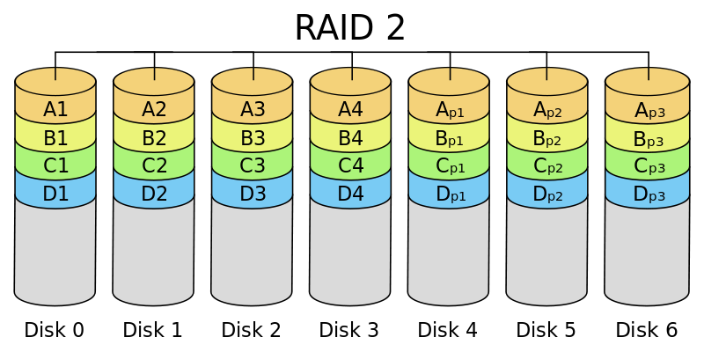
Disk Arrays RAID 2

Slide 36
Disk Arrays RAID 3
Byte level striping
Dedicated parity
All disk spindle rotation is synchronized
Parity is calculated across corresponding bytes and stored on a dedicated parity drive.
Not commonly used in practice
Implementations exists

Slide 37
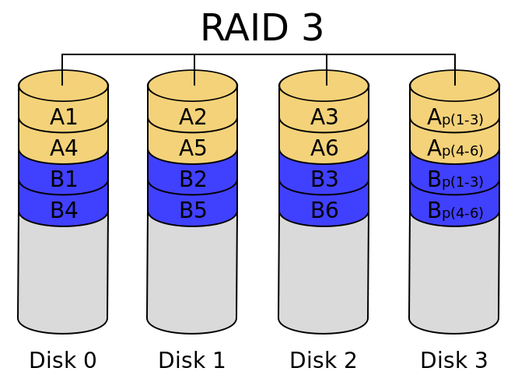
Disk Arrays RAID 3

Slide 38
Disk Arrays RAID 4
Block level striping
Dedicated parity
Is equivalent to Raid 5, with the difference that all the parity data is stored on a single drive.
Files are distributed between drives
Each drive operates independently
I/O request can be performed in parallel

Slide 39
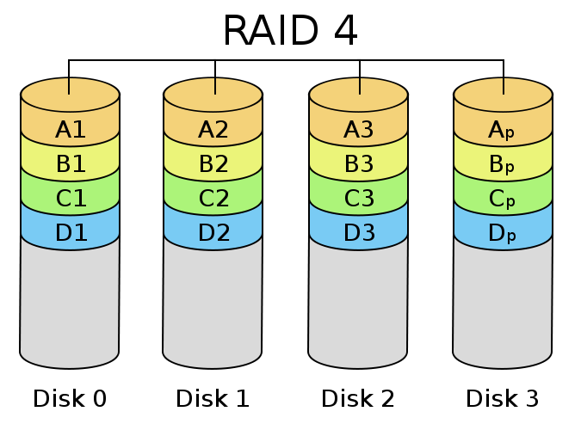
Disk Arrays RAID 4

Slide 40
Disk Arrays RAID 5
Block level striping
Distributed parity
Provides fault tolerance even if two disks fail
Distribute parity and data across all the drives

Slide 41
Disk Arrays RAID 5
Array is not destroyed by a single drive failure
Requires at least two disks
Good performance, good redundancy
Fast reads slow writes

Slide 42
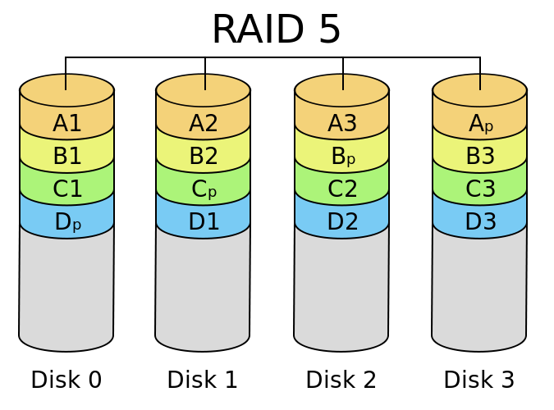
Disk Arrays RAID 5

Slide 43
Disk Arrays RAID 5
Total space available is ((number of drives -1) * size of smallest drive)
The more drives you use, the more efficient your storage space become, without losing any redundancy
The array can survive without a drive, but it is slow, the data must be rebuild on the fly.
Uses XOR to rebuild data and creates the parity strings

Slide 44
Disk Arrays RAID 5
XOR
Input |  | Output
0 | 0 | 0
0 | 1 | 1
1 | 0 | 1
1 | 1 | 0

Slide 45
Disk Arrays RAID 5
 | Drive 1 | Drive 2 | Drive 3 | Drive 4
Stripe 1 | 0100 | 0101 | 0010 | 0011
Stripe 2 | 0010 | 0000 | 0110 | 0100
Stripe 3 | 0011 | 0001 | 1010 | 1000
Stripe 4 | 0110 | 0001 | 1101 | 1010

Slide 46
Disk Arrays RAID 5
 | Drive 1 | Drive 2 | Drive 3 | Drive 4
Stripe 1 | 0100 | A | 0010 | 0011
Stripe 2 | 0010 | B | 0110 | 0100
Stripe 3 | 0011 | D | 1010 | 1000
Stripe 4 | 0110 | E | 1101 | 1010

Slide 47
How can we rebuild the lost disk?

Slide 48
Disk Arrays RAID 5
Just apply XOR with the remaining blocks
For example to rebuild the streap 1 of the disk two:
(stripe 1 disk 1) XOR (stripe 1 disk 3) XOR (stripe 1 disk 4) = (stripe 1 disk 2)
0100 XOR 0010 XOR 0011 = 0101

Slide 49
Disk Arrays RAID 6
Block level striping
double distributing parity
fault tolerance up to failed disks

Slide 50
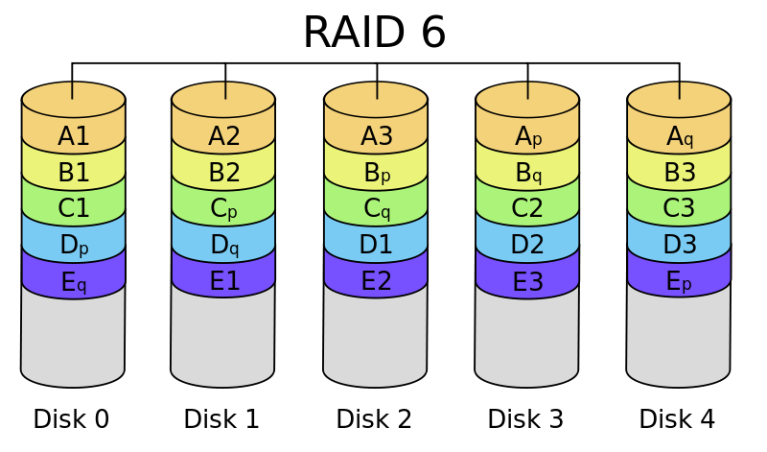
Disk Arrays RAID 6

Slide 51
Disk Arrays RAID 10
Often referred to RAID 1+0, stripe of mirrors
Mirroring and Striping
Data is written in stripes across primary disks
The primary disks have been mirrored to the secondary disks.

Slide 52
Disk Arrays RAID 10
Minimum 4 disks
Excellent Redundancy
Excellent performance
Best option to mission critical applications

Slide 53
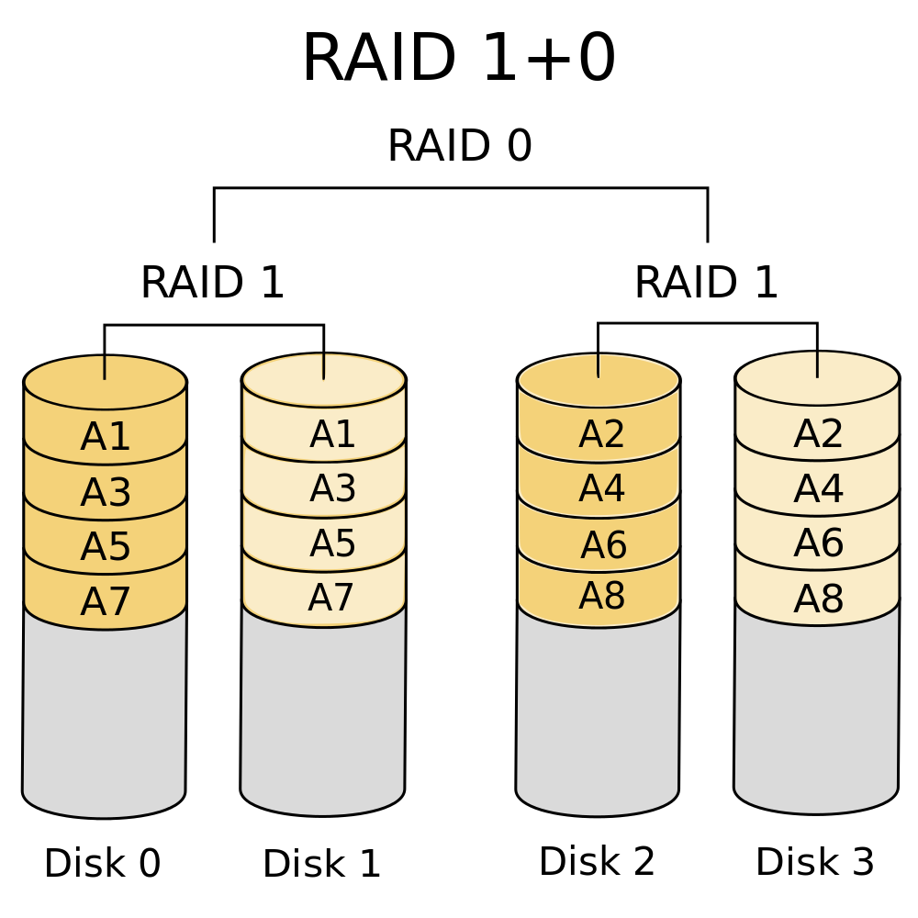
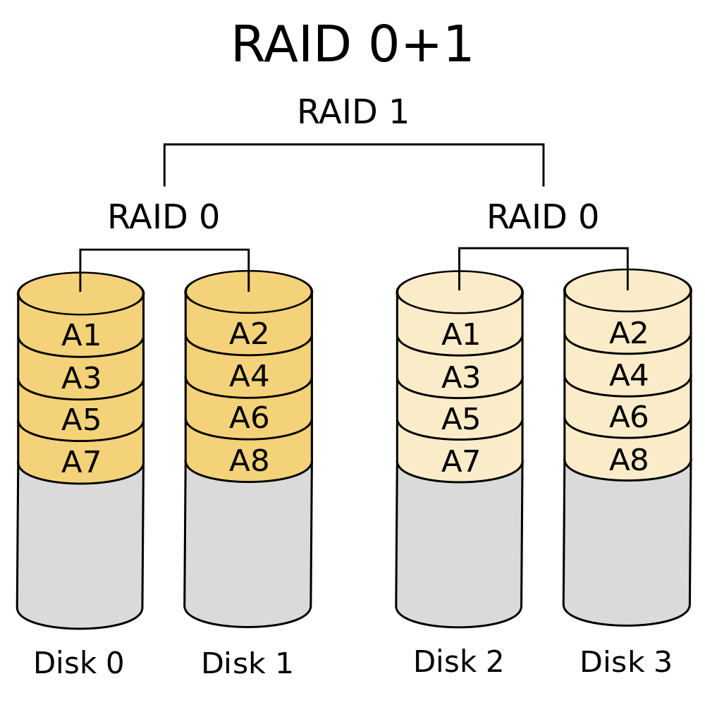
Disk Arrays RAID 10

Slide 54
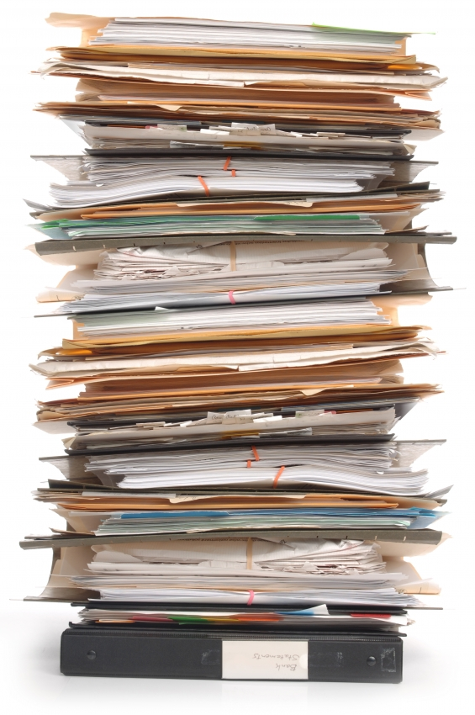
File Systems
We have learned about external storage from a hardware point of view
From now on, we will think of disks as linear sequence of blocks and supporting two operations:
Read block k
Write block k

Slide 55
File Systems
But, if all we have are these two operations:
How do we find information?
How do keep one user from reading another’s user data?
How do you know which blocks are free?

Slide 56
Processes
Address Space
Files
Directory
GUI
CPU
Memory
Disks
Video Memory
OS
User Abstraction
Hardware

Slide 57
File Systems
Just like with any other resources of the computer, the operating system provides an abstract representation: Files
Files are logical units of information created by processes
A disk may contain thousands of them, each one independent from the other

Slide 58
File Systems
Information in files must be persistent: not affected by process creation or termination
The part of the operating system dealing with files is known as the file system

Slide 59
File Systems
There are many types of file systems:
Ext2, Ext3 (Linux)
NTFS (Windows)
FAT, FAT32 (DOS, Windows)
CDFS (CD Rom)
Many others
Programmers use an API to interact with the file system

Slide 60
File Systems Requirements
Persistence
Performance
Size
Sharing
Protection
Ease of use
Random Access

Slide 61
File Systems Terminology
Disk: permanent storage.
Block/Sector: The smallest writable unit by a disk or FS. The FS block is always the same size as or larger than the disk block size.
Partition: Subset of blocks

Slide 62
File Systems Terminology
Volume: Name of collection of blocks. Disk or partition initialized with the FS.
Superblock: where the FS stores its critical information (size, name, etc)

Slide 63
File Systems Terminology
Plates
Sectors/Blocks
Tracks
Hard Disk Drive
Flat space organized in FS Blocks

Slide 64
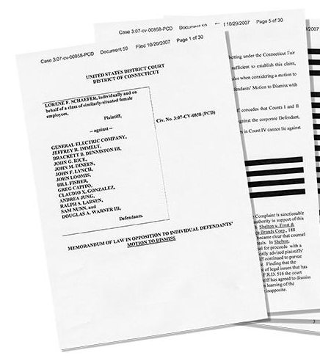
Files
A file is an abstraction mechanism
Provides a way to store information on a disk and read it back later
Shields the user from the details of how and where the information is stored and how the disks actually work

Slide 65
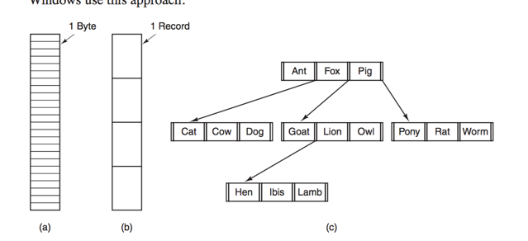
File Structure
There are three common possibilities for file structure:

Slide 66
File Structure
Byte Sequence
The operating system does not know or care what is in the file, only sees bytes.
Unix and Windows uses this approach
Provides maximum flexibility, the OS doesn’t help but also doesn’t get in the way

Slide 67
File Structure
Byte Sequence
These type of files are usually called plain files

Slide 68
File Structure
Fixed-length records
A file is a sequence of fixed-length records each with some internal structure
Read operation returns a complete record and Write operation overwrites or appends one record
Used in mainframe/midrange operating systems

Slide 69
File Structure
Tree of records
A file consists of a tree of records, not necessarily of the same length, each containing a key field
The tree is sorted by the key field to allow rapid searching for a particular key
The basic operation is not getting the next record, but a record with a specific key

Slide 70
File Structure
Tree of records

Slide 71
File Types
Regular files contain user information
Directories are system files for maintaining the structure of the file system
Character special files are related to I/O and used to model devices such as printers, terminals and networks

Slide 72
File Types
Block files are used to model disks
Binary files are executable programs
Archive files are module libraries

Slide 73
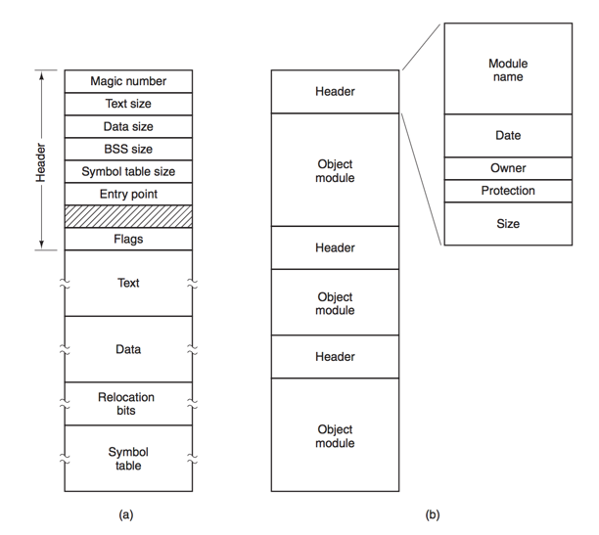
File Types

Slide 74
File Access
Sequential Access
Provided in early operating systems
A process could only read all the bytes or records in a file in order, starting at the beginning, but could not skip around and read as often as needed
Used when the storage was magnetic tape

Slide 75
File Access
Random Access File
Introduced with the usage of disks
Allow to read bytes or records of a file out of order or to access records by key rather than by position
Essential for many applications, for example database systems

Slide 76
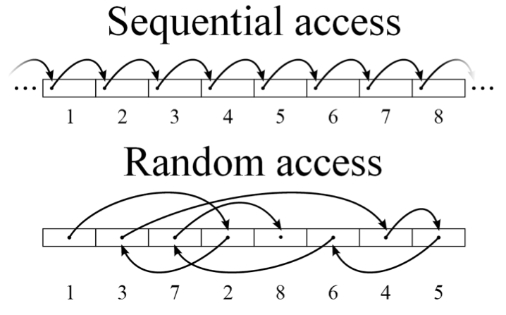

Slide 77
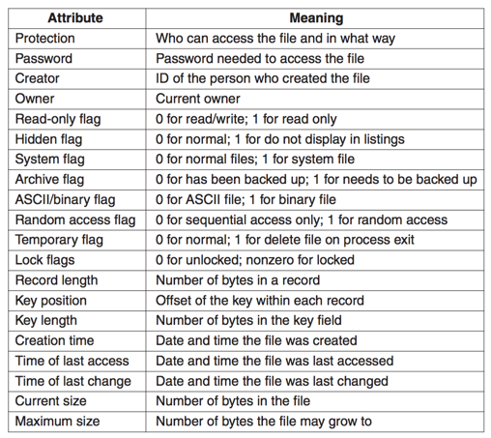
File Metadata

Slide 78
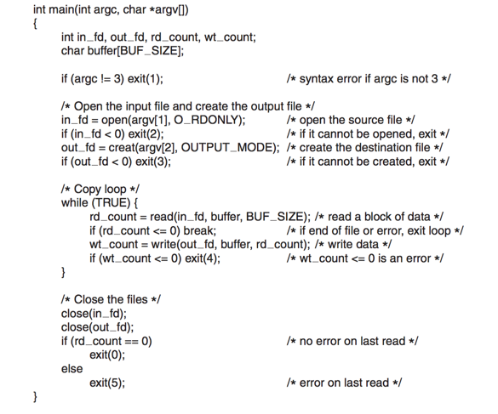
File System calls

Slide 79
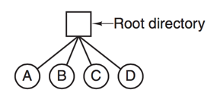
Directories
Special files used to keep track of files
The simplest form of directory system is having one directory containing all files

Slide 80
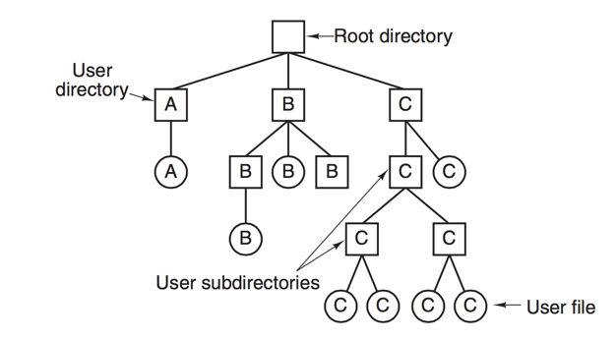
Directories
Having all files in a single directory was not useful for general applications
A hierarchical directory system (tree of directories) allowed to have as many directories as needed grouped in a suitable way

Slide 81
File System implementation Layout
File systems are stored on disks
Sector 0 of the disk is called Master Boot Record (MBR) and is used to boot the computer
At the end of the MBR is the partition table

Slide 82
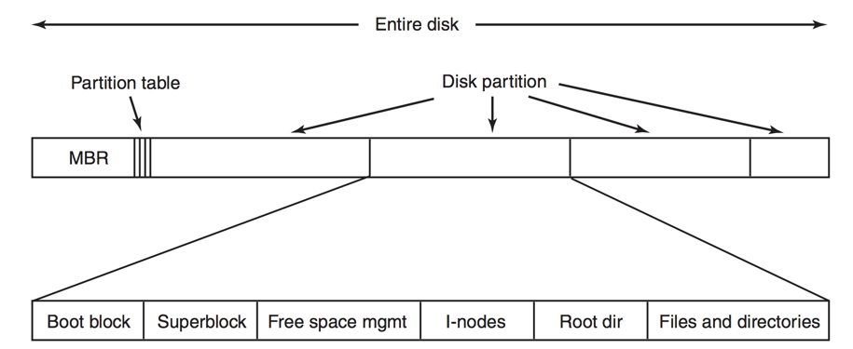
File System implementation Layout
Small program that loads the operating system in the partition

Slide 83
File System implementation Layout
Key parameters of the files system. i.e how many blocks are in the file system

Slide 84
File System implementation Layout
Array of data structures, how per each file in the file system. Metadata

Slide 85
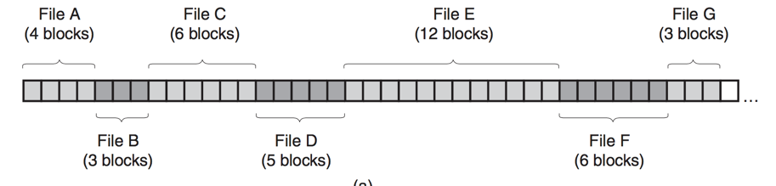
File System implementation Files
How to keep track of which blocks go with which file?
Contiguous Allocation: all blocks of a file are physically next one of each other

Slide 86
File System implementation Files
How to keep track of which blocks go with which file?
Contiguous Allocation: all blocks of a file are physically next one of each other
De-fragmentation is extremely expensive in secondary memory

Slide 87
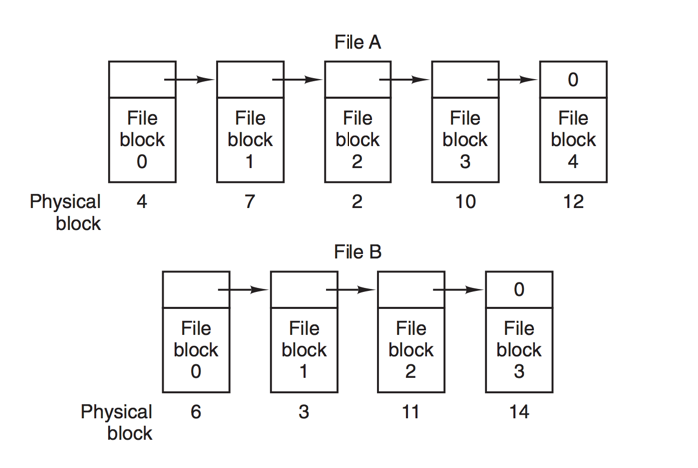
File System implementation Files
Linked-List Allocation: keep each file as a linked list of disk blocks

Slide 88
File System implementation Files
Linked-List Allocation: keep each file as a linked list of disk blocks
Random access is painful
These pointers are on the disk not on memory

Slide 89
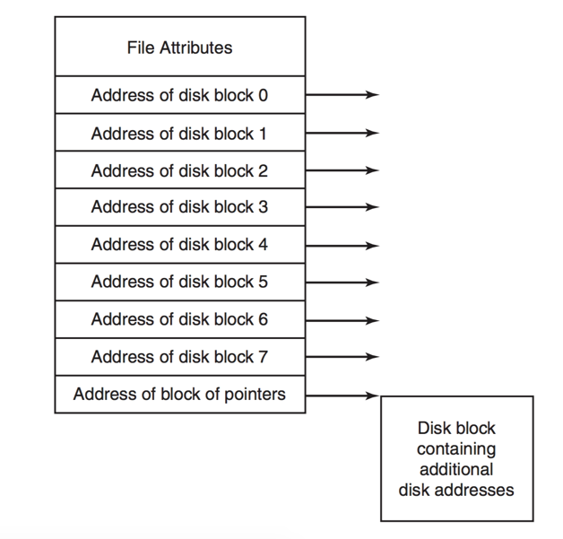
File System implementation Files
i-Nodes (index-node) associate each file with a data structure which lists the attributes and disk addresses of the file’ s block

Slide 90
File System implementation Inodes
15 pointers
12 pointers to data blocks
13th indirect block, block containing pointers to data blocks.
14th doubly-indirect data blocks (128 pointers).
15th triply-indirect data blocks

Slide 91
File System implementation Inodes
Maximun File Size
2113676 data blocks * 512 Kb = 1032 GB
Inode
1 | 2 | 3 | 4 | 5 | 6 | 7 | 8 | 9 | 10 | 11 | 12
1 | 2 | ... | 128
1 | 2 | ... | 128
1 | 2 | ... | 128
128 single data blocks * 128 data blocks = 16384 data blocks
128 double data blocks * 128 single data blocks * 128 data blocks = 2037152 data blocks

Slide 92
File System implementation Files
The main advantage of this scheme is that the i-node need to be in memory only when the corresponding file is opened
Less overhead

Slide 93
File System implementation Important
Hotspare
Rebuild drive
Raid Controller
Software Raid
Hardware Raid
Nested Raid Levels
Direct Memory Access

Slide 94
External Storage Structures
CE-2101 Algorithms and Data Structures

